Slide 1


Comparative Study of Classifiers on Human Activity Recognition by Different Feature Engineering Techniques
Department of Electrical and Computer Engineering North South University Dhaka, Bangladesh
Intelligent Systems IS'20
Mahbuba Tasmin, Taoseef Ishtiak, Sharif Uddin Ruman,Arif ur Rahman Chowdhury Suhan, N.M. Shihab Islam,Sifat Jahan, Md. Sajid Ahmed, Md. Shahnawaz Zulminan, Abdur Raufus Saleheen, Dr. Rashedur M. Rahman
Contact Email: rashedur.rahman@northsouth.edu

Slide 2







Introduction
Enhanced Recognition Task
Final Result
Faster Computation
Low Resource Dependency
Research Expectation | Presenting the significance of a feature engineering pipeline on large HAR dataset for faster computation with improved accuracy and low-resource dependency infrastructure aimed for activity-recognition tasks through comparative analysis.

Slide 3
RESEARCH CONTRIBUTION
Result Statement | Accuracy score of activity-recognition improves to 78.5% by Multi-layer perceptron model from 76.7% after feature engineering applied on raw dataset by Extra-tree classifier method.
Highlights | Feature Engineering through Tree-based Selection Methods Dimensionality Reduction of dataset through PCA Performance Evaluation of baseline five classifier model

Slide 4
DATASET
Source | Collected from UCI Machine Learning Repository, Human Activity Recognition from Continuous Ambient Sensor Dataset (Published – September 20,2019)
Number of Activities | 12
Number of Attributes | 37
Attribute Characteristics | Integer/Real with missing data, 4M instances (approx)
Selected number of activities for this Study | 'Cook':0, 'Eat':1, 'Phone':2, 'Read':3, 'Watch_TV':4

Slide 5
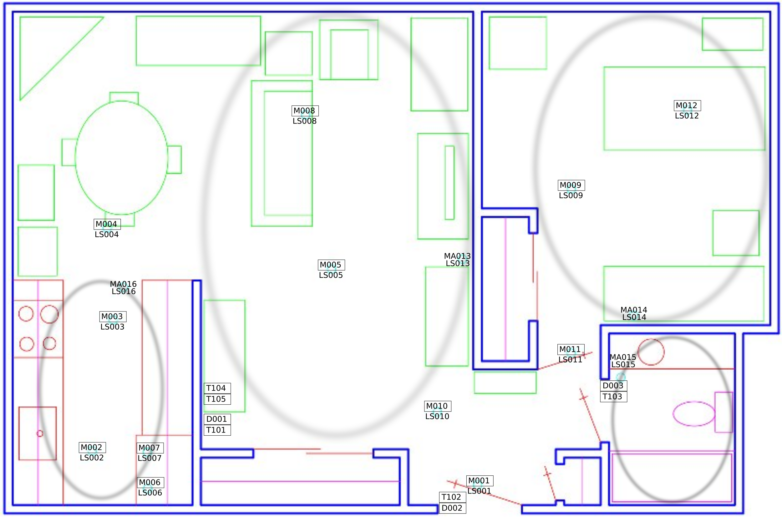
DATA COLLECTION SETUP

Slide 6
METHODOLOGY
Original Dataset
Scraped Dataset ( Five Activities)
Feature Engineering
Feature Sets generation
Performance Evaluation
Classifier Training
Train and Test set Preparation
Dimensionality Reduction (PCA=5)
Figure 1: Workflow of the proposed Approach

Slide 7
FEATURE ENGINEERING
Selects significant features from original 37 attributes.
Produces four different data-sets from original dataset.
Four variations of Tree-based Feature Selection Approaches
Variants | Name
Feature Engineering through ML model | Tree-based Feature Selection | Feature Selection with Random Forest
Feature Rank Generation by Node-impurity Score | Extra-Tree Classifier | Random Forest Classifier

Slide 8
SELECTED FEATURE SETS THROUGH FEATURE-ENGINEERING
Attribute Name | Description
LastSensorEventHours (Integer) | These attributes refer to the last recorded time of activity.
LastSensorEventSeconds (Decimal)
LastSensorDayOfWeek (Symbolic-value integer)
windowDuration | It represents the duration of 30 event sliding window in seconds
LastSensorLocation (symbolic-valued integer) | Sensor location ID in the activity window.
LastMotionLocation (symbolic-valued integer) | It refers the location ID of last motion sensor used in the window
sensorCount-Kitchen (decimal) | For most recent event 1.0 is added, and for each previous event (n-0.01) is cumulatively added of the current recorded event. Records the weighted event count of tagged location.
sensorCount-LivingRoom (decimal)

Slide 9
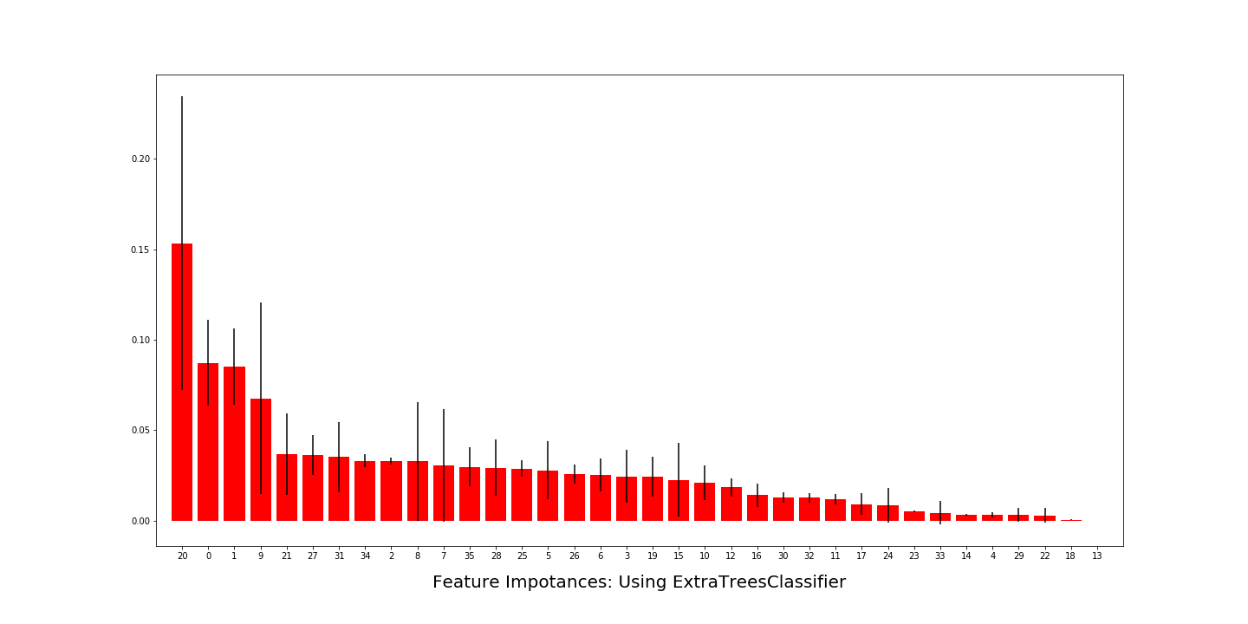
Feature Rank Generation
Extra-Tree Selection
sensorCount-Ignore (Decimal)
- Weighted count of the recorded events from the latest activity (score 1.0) to the first recorded activity (score n-0.01).

Slide 10
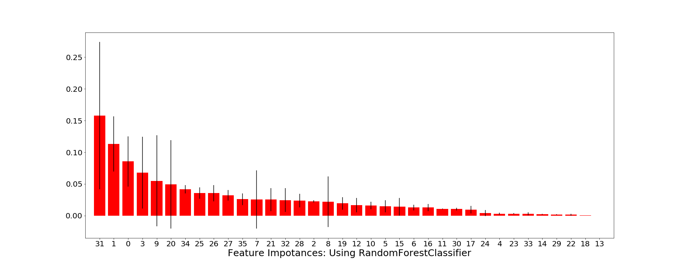
Feature Rank Generation
Random Forest Selection
sensorElTime-Ignore (Decimal)
The last recorded activity time of this sensor on maximum 86400 period.

Slide 11
FINAL FEATURESET GENERATION
Reduces the number of instances from previously feature-engineered dataset.
Unsupervised dimensionality reduction of feature set through Principal Component Analysis (PCA=5).
Projected variance ratio tested against K(K=3) nearest neighbor classifier on the 5-dimensional projected points.

Slide 12
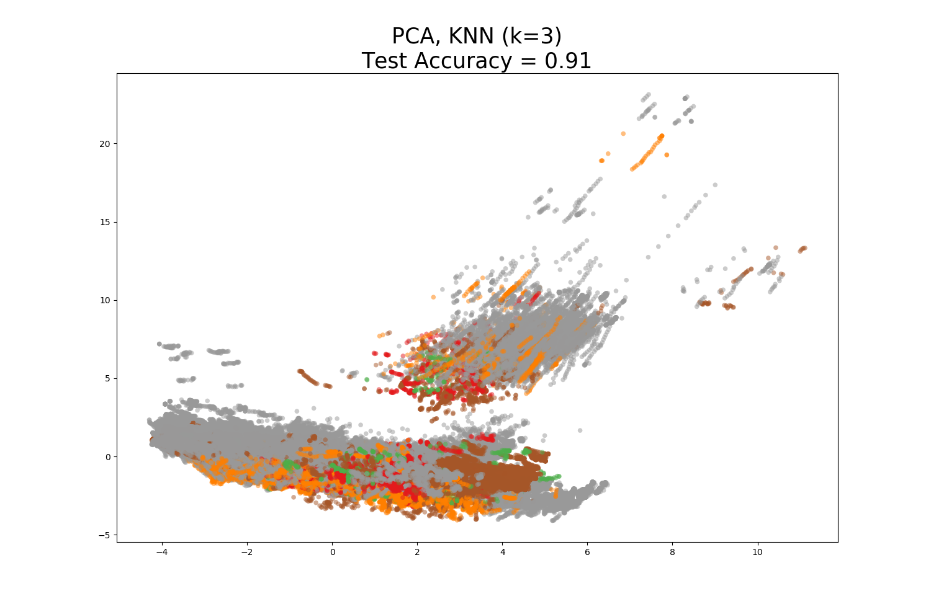
Variance Ratio Evaluation against KNN
Reduced subspace of dataset – 5-point projected space.
KNN verifies the variance ratio.
91% variance of data-instances covered.
Figure II: Variance Test Accuracy for PCA-5 Dimensionality Reduction

Slide 13
BASELINE CLASSIFIER MODELS
K Nearest Neighbors
Decision Tree
Random Forest
Gaussian Naive Bayes
MLP Classifier using Backpropagation

Slide 14
PERFORMANCE EVALUATION
Five classifier models evaluated for each five feature sets(feature engineered=4, original=1)
Feature engineering significance inferred from variance of accuracy score from the evaluation sets.
Classifier | Original Set of 37 Features | Model Obtained Selected Features with Tree-based Feature Selection | Model Obtained Selected Features with Random Forest Classifier | Top 21 Extracted Features by Extra Tree Classifier | Top 21 Extracted Features by Random Forest Classifier
Nearest Neighbor | 74.2 | 75.4 | 72.9 | 75.7 | 75.3
Decision Tree | 75.3 | 76.9 | 75.9 | 76.3 | 75.5
Random Forest | 74.4 | 76.4 | 75.7 | 75.9 | 74.5
Naive Bayes | 74.9 | 76.5 | 76.4 | 76.9 | 76.3
Neural Net | 76.7 | 78.3 | 77.3 | 78.5 | 78.1
TABLE I: Comparison of Percentage in Accuracy Scores of Classifiers on Feature sets

Slide 15
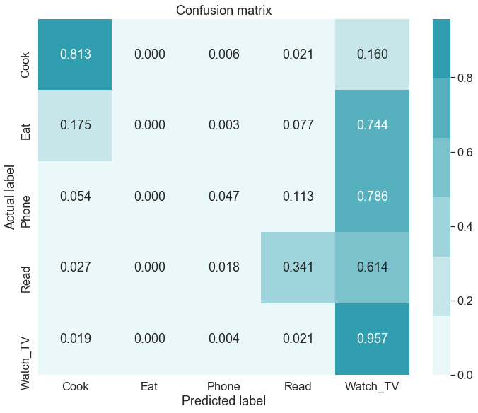
Recognition Score
Better Accuracy Scores: Cook, Read, Watch TV
Lower Accuracy Scores: Eat, Phone
FIGURE III: Evaluation Metric of Neural Network on Extra Tree Classifier Feature set.

Slide 16
DISCUSSION
The proposed work has suggested how tree-based classifier and methods are effective for important feature selection to make the training process faster.
The proposed methodology also validates the fact that model training accuracy can be increased through elimination of redundant features and reduction of noisy instances by Dimensionality Reduction.
Makes up a Computationally inexpensive classification scheme based on baseline machine-learning models.

Slide 17
Future Work
Scope of Application | Example
Time-series Data | Faster data-analysis and low-cost structural support for ML model analysis.
Activity Surveillance | Ambient Assisted Living
 | Health Sector (Isolation/Quarantine)
 | Indoor Human-Activity Recognition

Slide 18

Thank you!
Questions?

